Slide 1



WWW.GROUNDGURUS.COM

Slide 2




Slide 3


Slide 4


Slide 5

WHAT IS REACT ?
Open source library for building user interfaces
NOT A FRAMEWORK
Focus on UI
Rich Ecosystem

Slide 6
WHY LEARN REACT ?
Created and maintained by Facebook
More than 100K starts in GitHub
Huge Community
In demand skills

Slide 7


Slide 8
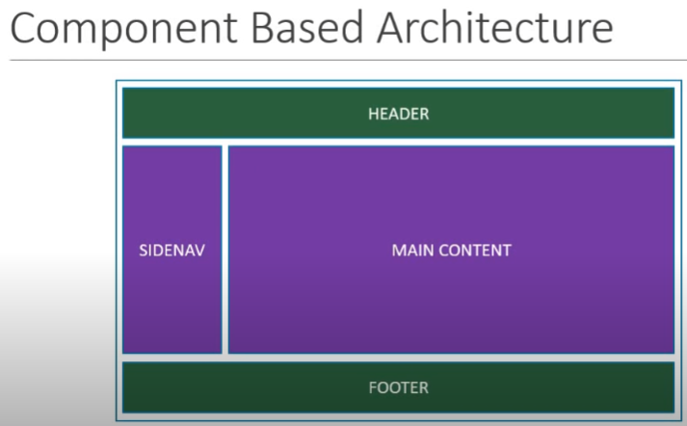

Slide 9
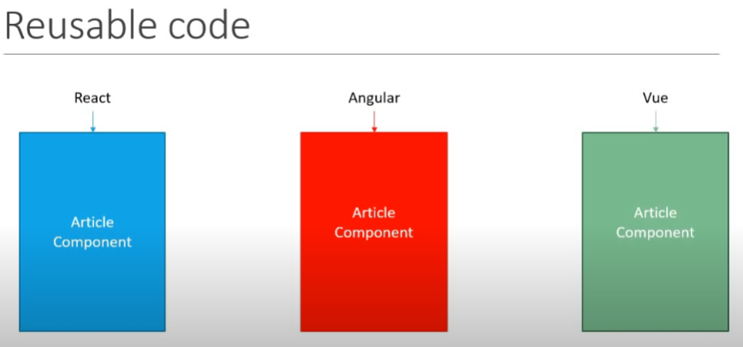

Slide 10
Tools
Development Tools
Visual Studio Code
ReactJS Code Snippets (charalampos karypidis)
Node.js
Database
Firebase (Needs google account)

Slide 11
PREREQUISITES :
HTML
CSS
JavaScript
ES6

Slide 12
ES6 (ECMAScript 6)
React uses the following ES6 features
Classes
arrow functions
Variables (let, const, var)
Array Methods like .map()
Modules
Ternary Operators
Spread operators
Destructuring

Slide 13
ES6 Classes
ES6 introduced classes.
A class is a type of function, but instead of using the keyword function to initiate it, we use the keyword class, and the properties are assigned inside a constructor() method
class Customer {
constructor(name) {
this.brand = name;
}
}

Slide 14
ES6 Arrow Functions
Arrow functions allow us to write shorter function syntax
Before :
hello = function() {
return "Hello World!";
}
With Arrow Function :
hello = () => {
return "Hello World!";
}

Slide 15
ES6 Variables
there are three ways of defining your variables: var, let, and const.
var x = 5.6;
let x = 5.6;
const x = 5.6;

Slide 16
ES6 Array Methods
One of the most useful in React is the .map() array method.
const myArray = ['apple', 'banana', 'orange'];
const myList = myArray.map((item) => <p>{item}</p>)

Slide 17
ES6 Destructuring Arrays
Here is the old way of assigning array items to a variable
Before :
const vehicles = ['mustang', 'f-150', 'expedition'];
// old way
const car = vehicles[0];
const truck = vehicles[1];
const suv = vehicles[2];
With destructuring :
const vehicles = ['mustang', 'f-150', 'expedition'];
const [car, truck, suv] = vehicles;

Slide 18
ES6 Modules
JavaScript modules allow you to break up your code into separate files.
ES Modules rely on the import and export statements.
In-line individually:
export const name = "Jesse"
export const age = 40
All at once at the bottom:
const name = "Jesse"
const age = 40
export { name, age }

Slide 19
ES6 Ternary Operator
The ternary operator is a simplified conditional operator like if / else.
Before:
if (authenticated) {
renderApp();
} else {
renderLogin();
}
With Ternary:
authenticated ? renderApp() : renderLogin();

Slide 20
DEMO : MYFIRST APP

Slide 21
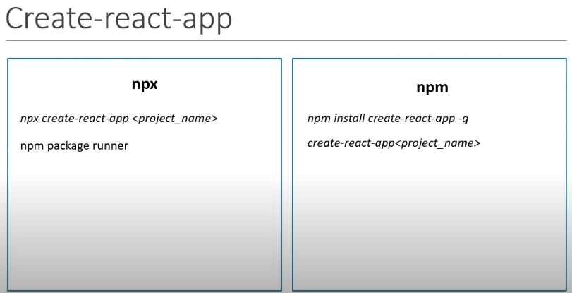

Slide 22
NPM Install
npm install firebase
npm install react-router-dom
npm install bootstrap@4.1.1
npm install react-scripts@latest
npm install react@^17.0.0 react-dom@^17.0.0 –save

Slide 23
FOLDER STRUCTURE / FILES
Package.json – contains the file dependencies
Package-lock.json – ensure consistent installation of dependencies
Node_modules – where all dependencies are installed
Manifest.json – progressive web apps (out of scope)
Index.html – the only html file for the whole application / single application concept
Index.js – starting point of the react application
Specify the root component which is the <App /> component
And the DOM element which will be controlled by React
App.js – responsible for the display in index.html
Represent the “View” which we see in the browser

Slide 24
React Render HTML
React renders HTML to the web page by using a function called ReactDOM.render().
he purpose of the function is to display the specified HTML code inside the specified HTML element.
ReactDOM.render(<p>Hello</p>, document.getElementById('root’));
The result is displayed in the <div id="root"> element:
<body>
<div id="root"></div>
</body

Slide 25
React JSX
JSX stands for JavaScript XML, allows us to write HTML in React.
JSX:
const myelement = <h1>I Love JSX!</h1>;
ReactDOM.render(myelement, document.getElementById('root’));
Without JSX:
const myelement = React.createElement('h1', {}, 'I do not use JSX!');
ReactDOM.render(myelement, document.getElementById('root'));

Slide 26
React Props
React Props are like function arguments in JavaScript and attributes in HTML.
const myelement = <Car brand="Ford" />;
function Car(props) {
return <h2>I am a { props.brand }!</h2>;
}

Slide 27
React Events
React can perform actions based on user events.
React has the same events as HTML: click, change, mouseover etc.
React:
<button onClick={shoot}>Take the Shot!</button>
HTML:
<button onclick="shoot()">Take the Shot!</button>

Slide 28
React Conditional Rendering
In React, you can conditionally render components.
If Statement
We can use the if JavaScript operator to decide which component to render.
Sample Components
function MissedGoal() {
return <h1>MISSED!</h1>;
}
function MadeGoal() {
return <h1>Goal!</h1>;
}

Slide 29
React Lists
In React, you will render lists with some type of loop
The JavaScript map() array method is generally the preferred method
Keys
Keys allow React to keep track of elements.
This way, if an item is updated or removed, only that item will be re-rendered instead of the entire list.
Keys need to be unique to each sibling. But they can be duplicated globally.

Slide 30
React Forms
React uses forms to allow users to interact with the web page.
function MyForm() {
return (
<form>
<label>Enter your name:
<input type="text" />
</label>
</form>
)
}
ReactDOM.render(<MyForm />, document.getElementById('root'));

Slide 31
React Router
Declarative routing for React web applications.
Add React Router
npm i -D react-router-dom
Folder Structure
To create an application with multiple page routes, let's first start with the file structure.

Slide 32
React CSS Styling
There are many ways to style React with CSS, this tutorial will take a closer look at three common ways:
Inline styling
To style an element with the inline style attribute, the value must be a JavaScript object:
CSS stylesheets
You can write your CSS styling in a separate file, just save the file with the .css file extension, and import it in your application.
CSS Modules
CSS Modules are convenient for components that are placed in separate files.

Slide 33
COMPONENTS

Slide 34
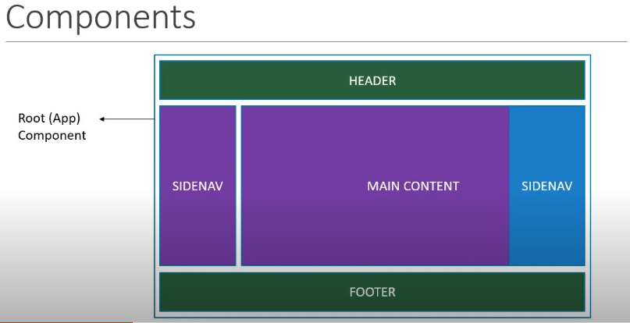

Slide 35
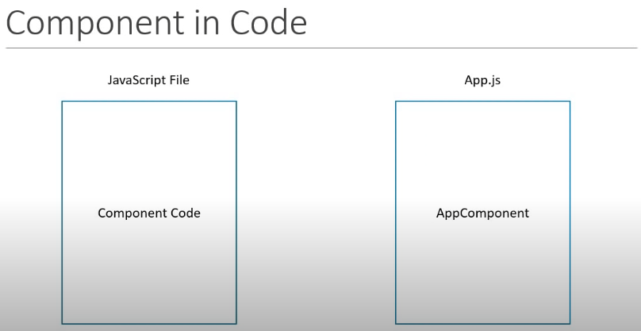

Slide 36
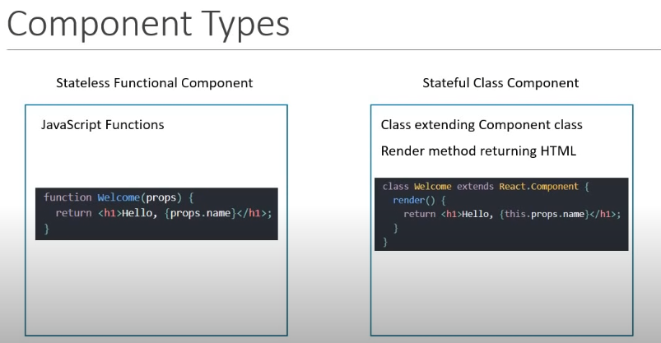

Slide 37
React Components
Components are independent and reusable bits of code.
Components come in two types, Class components and Function components
Creating Class component
When creating a React component, the component's name must start with an upper case letter.
Class Component:
class Customer extends React.Component {
render() {
return <h2>Hi, I am a Jok!</h2>;
}
Function Component:
function Customer() {
return <h2>Hi, I am a Jok!</h2>;
}

Slide 38
React Components Lifecycle
Each component has several “lifecycle methods” that you can override to run code at particular times in the process.
Mounting:
These methods are called in the following order when an instance of a component is being created and inserted into the DOM:
constructor()
static getDerivedStateFromProps()
render()
componentDidMount()

Slide 39
React Components componentDidMount()
If you need to load data from a remote endpoint, this is a good place to instantiate the network request.

Slide 40
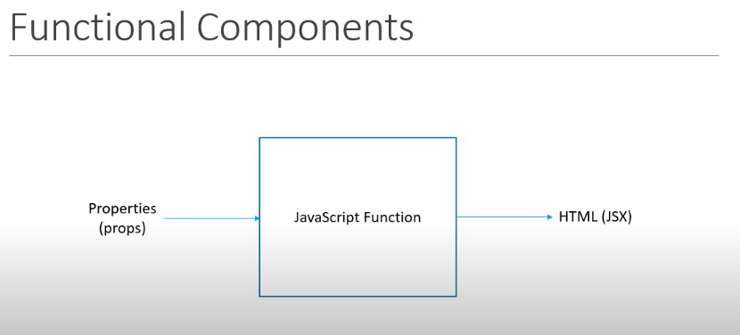

Slide 41
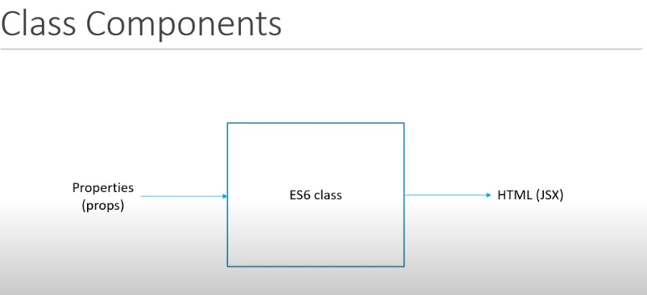

Slide 42
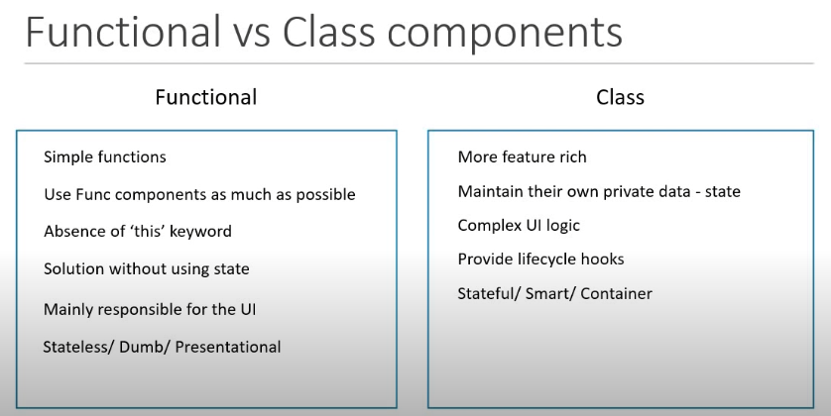

Slide 43
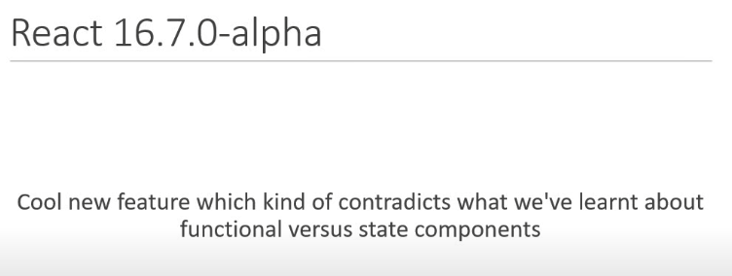

Slide 44
React State
React components has a built-in state object.
The state object is where you store property values that belongs to the component.
When the state object changes, the component re-renders.

Slide 45
Session 3
- React Hooks
- React Redux
- Ecommerce Stateless

Slide 46
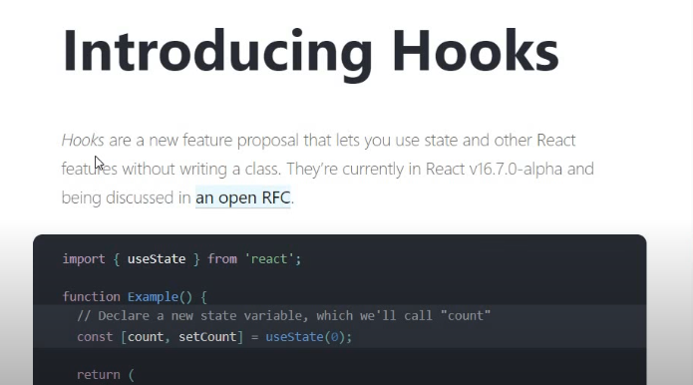

Slide 47
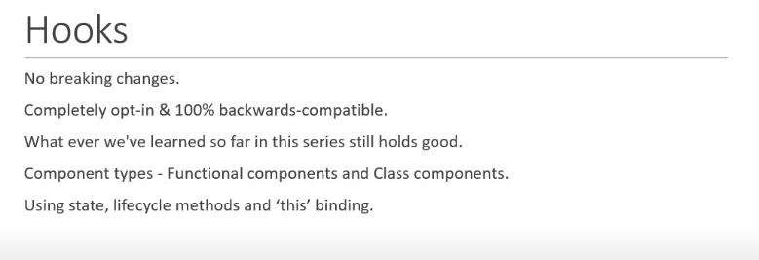

Slide 48
React Hooks
Hooks allow function components to have access to state and other React features. Because of this, class components are generally no longer needed.
Hooks were added to React in version 16.8.
Hooks allow us to "hook" into React features such as state and lifecycle methods.

Slide 49
React useState Hook
The React useState Hook allows us to track state in a function component.
State generally refers to data or properties that need to be tracking in an application.
Initialize useState :
import { useState } from "react";
function FavoriteColor() {
const [color, setColor] = useState("");
}

Slide 50
React useEffect Hook
The useEffect Hook allows you to perform side effects in your components.
Some examples of side effects are: fetching data, directly updating the DOM, and timers.
useEffect accepts two arguments. The second argument is optional.
useEffect(<function>, <dependency>)

Slide 51
React useContext Hook
React Context is a way to manage state globally.
It can be used together with the useState Hook to share state between deeply nested components more easily than with useState alone.

Slide 52
React Component Redux

Slide 53
React Redux
Redux is a predictable state container for JavaScript apps. As the application grows, it becomes difficult to keep it organized and maintain data flow.
Redux solves this problem by managing application’s state with a single global object called Store.
Installation:
NodeJS and NPM should be installed before hand

Slide 54
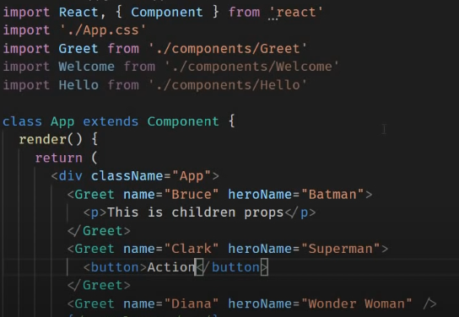
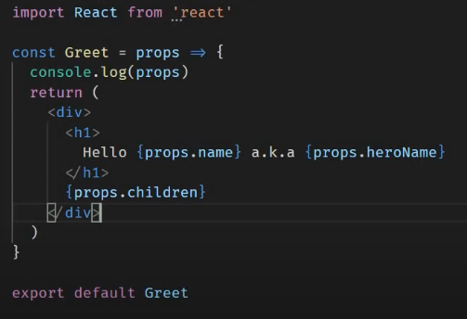

Slide 55
INTRODUCING JSX

Slide 56
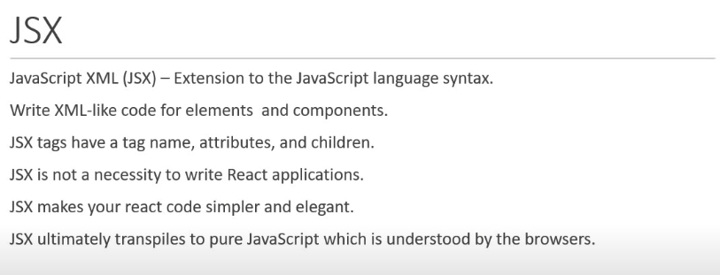

Slide 57
PROPS AND STATE

Slide 58
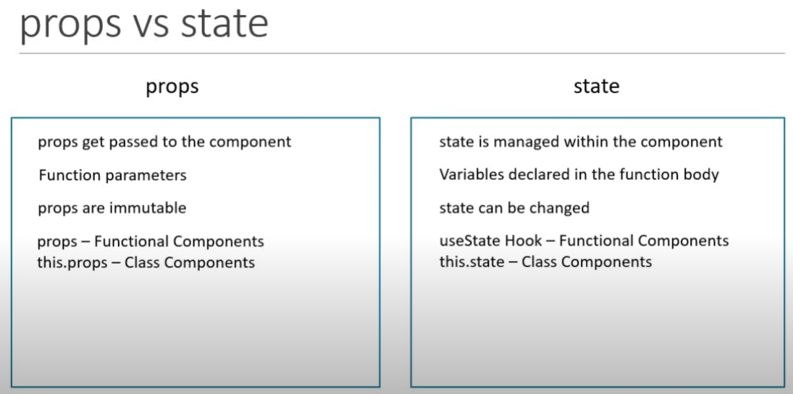

Slide 59


